Slide 1

Model Selection (and Validation)
Part II
Rayid Ghani and Kit Rodolfa

Slide 2
Reminders
This week:
Project check-in on Wednesday (we’ll send around times/locations)
Temporal Validation “whiteboard” session Thursday
Project Assignment due on Friday – see template slides and canvas post
Coming up next week:
Monday Feedback From
Question: How is teamwork going so far?
Next project assignment due following Monday (Oct 19)
Modeling plan and training/validation sets

Slide 3
Group Meetings – Wednesdays Going Forward
With Kit in XXXXXX
6:20 – 6:50 EPA Teams
6:50 – 7:20 Turnout Teams
With Rayid in XXXXXX
6:20 – 6:50 Schools Teams
6:50 – 7:20 Bills Teams

Slide 4
Plan for the week
What you should be discussing this week within your team
Finalizing your analytical formulation and baselines to compare against
Validation strategy & temporal parameters
What you should be building this week
Cohort Query
Label Query
Evaluation Metrics

Slide 5
Scope
Data
Exploration
Modeling
Get Data
Store Data
Link Data
Rows
Features
Labels
Model Selection
Train-Test Splits
Performance Metrics
Model Interpretation
Entities
temporal
Spatial
…
Models
Dealing with Bias and Fairness
Field Trial Design
Deployment
Monitoring
Goals, Actions, Data, Analysis, Ethics

Slide 6
What is the goal of model selection?
You’ve run a large number of different types of models varying …
You need to understand what types of models are effective under what circumstances, and
You need to decide which one(s) to use in the future

Slide 7
What do we need our selected model to do?
Perform well
What metric?
Compared to what?
Generalize
To what?

Slide 8
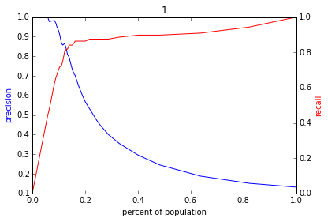
Reminder: The PR-k Curve
Score
1 .9 .8 .7 .6 .5 .4 .3. .2 .1
| | | | | | | | | |
Baseline

Slide 9
Other Metrics You’ve Used?

Slide 10
Other Metrics You’ve Used?
Area Under the ROC Curve
F1 Score
Accuracy
When would you use each of these?
How would you explain what they mean to a policy maker?

Slide 11
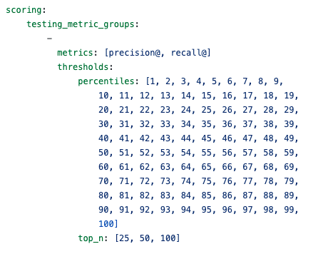
Evaluation – triage configuration

Slide 12
What should the model we select generalize to?

Slide 13
What do need to know to perform model selection
Deployment scenario
Model selection Methodology
Metric(s) (need to match your policy goals)
Comparison with baselines (to know if you’re effective)

Slide 14
How do we select a model that does that?

Slide 15
Model Selection - Methodology
In-sample
Out of sample
Multiple Out-of-sample (Hold-out) Splits
Cross Validation
Leave one out (LOO)
K fold
Temporal Holdouts
Spatial Holdouts
Other Holdouts?

Slide 16
Scenarios
1: We want to track news coverage of epidemic related topics. We have tagged a small corpus (n=1000) of news articles from Jan 2019 to September 2020 and now have a stream of new incoming articles every day. We want to deploy a system that tells us something about intensity of coverage by media outlet going forward.
What should our model generalize to?
What is a training set?
What is the corresponding validation set?

Slide 17
Scenarios
2: We want to track news coverage of epidemic related topics. We have tagged a small corpus (n=1000) of news articles from Jan 2019 to September 2020 and now have a stream of new incoming articles every day. We want to deploy a system that tells us something about intensity of coverage by media outlet over the last 2 years as well as going forward.
What should our model generalize to?
What is a training set?
What is the corresponding validation set?

Slide 18
Scenarios
3: We want to predict whether there will be an increase in epidemic related articles in the media during the next week.
What should our model generalize to?
What is a training set?
What is the corresponding validation set?

Slide 19
Scenarios
4: We want to predict whether there will be an increase in epidemic related articles in the media during the next month.
What should our model generalize to?
What is a training set?
What is the corresponding validation set?

Slide 20
Parameters
How far back to go when training models? (max training history)
To the beginning of time (expanding training window)?
Fixed history (rolling training window)?
Something else?
How far back do you get your features from?
How much to move forward from train-validation pair 1 to train-validation pair 2?
A day?
A month?
Something else?

Slide 21
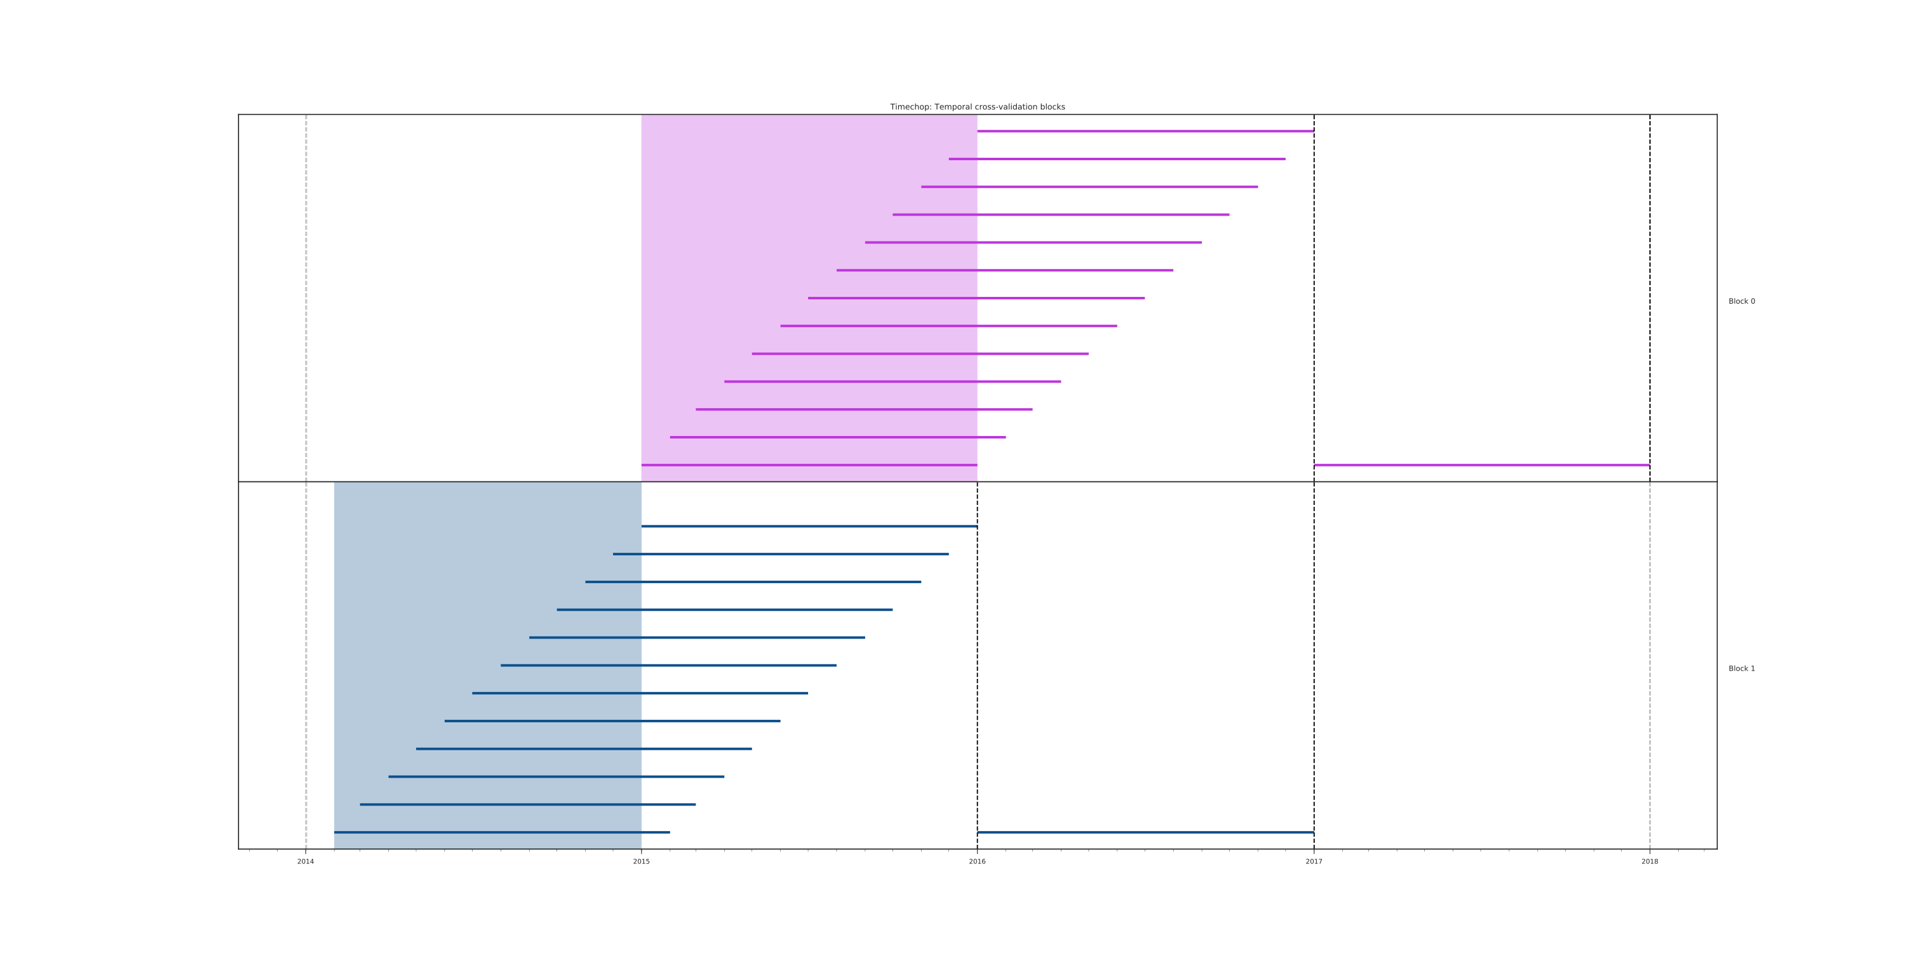
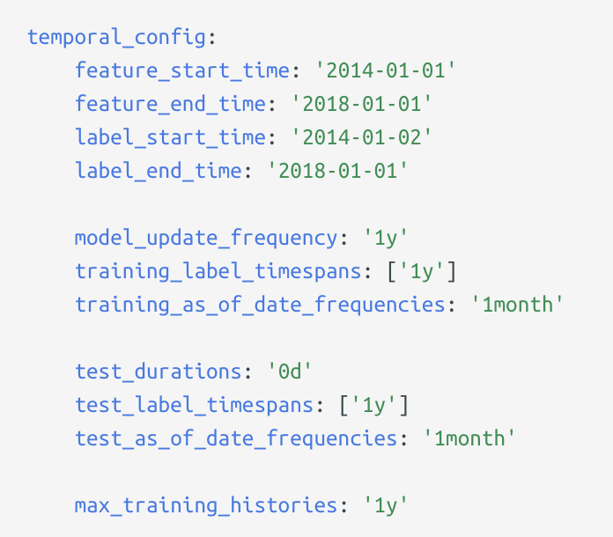
2014 2015 2016 2017 2018

Slide 22
Other considerations
If making repeated predictions about the same entity at different times, how often should an entity be repeated in the training data?
In an event-based deployment setup?
In a “take action at regular-ish intervals” deployment?
What about in the validation set?

Slide 23
Some tips
Set up validation set(s) to match deployment scenarios (and constraints)
Set up training set(s) any way we want but match data (both features and labels) available at training time
Making sure labels are not censored based on label period
Sampling (if helpful)
Data collection and update lag

Slide 24
Train Validation Pairs
 | Train Set |  |  |  | Validation Set
Train-Validation Pair ID | Earliest project submission date | Latest project submission date | Start date for labels | End date for labels | Start date for rows | End date for rows | Start date for labels | End date for labels
1
2
3 (most recent)
Train-Validation Pair 1
Training Examples
Label Buffer
Validation Examples
Label Buffer
Train-Validation Pair 2
Training Examples
Label Buffer
Validation Examples
Label Buffer

Slide 25
In-sample
Data
Train
Validate

Slide 26
Out-of-Sample
Data
Train
Validate

Slide 27
N-fold Cross-Validation
Data
1
2
3
4
5
Train
Validate

Slide 28
N-fold Cross-Validation
Data
1
2
3
4
5
Train
Validate

Slide 29
N-fold Cross-Validation
Data
1
2
3
4
5
Train
Validate

Slide 30
N-fold Cross-Validation
Data
1
2
3
4
5
Train
Validate

Slide 31
N-fold Cross-Validation
Data
1
2
3
4
5
Train
Validate

Slide 32
Temporal Holdouts
Data
2002 2017
Train
Validate
2002 2007 2008
Train
Validate
2002 2008 2009
Train
Validate
2002 2009 2010

Slide 33
Training - Time splits
Train
Validate
2002 2009 2010
Train
We only use this time
to get outcomes
2002 2009

Slide 34
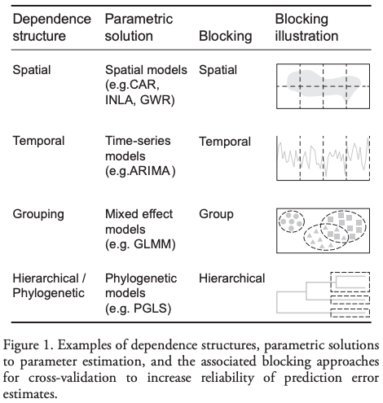
Evaluation - Methodology
In-sample
Out of sample
Multiple Out-of-sample (Hold-out) Splits
Cross Validation
Leave one out (LOO)
K fold
Holdouts Using Structure of Data
Temporal
Spatial, Hierarchical, etc.

Slide 35
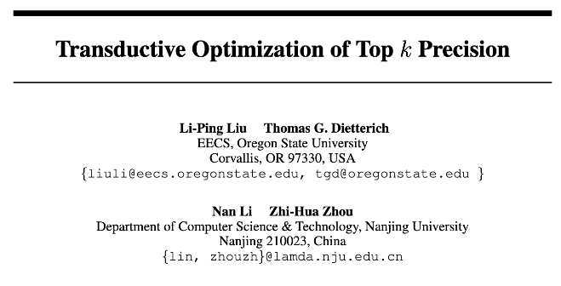
Some Open Research Questions

Slide 36
Some Open Research Questions
The SVM loss function will find the “best” separating hyperplane overall, but perhaps we could draw a better hyperplane to separate just k positive examples?
Transductive method: needs to be aware of the test set without labels to select just k test examples.
Modified gradient descent procedure to project gradient direction for L2-regularized SVM loss onto a “feasible solution cone” such that no more than k test examples will be predicted positive after the step.

Slide 37
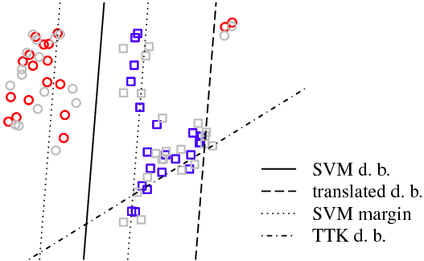
Some Open Research Questions

Slide 38
Some Open Research Questions
Paper shows improvements on synthetic examples and some “standard” datasets, but still more to investigate:
Can be slow to converge on larger datasets
“At most” k examples can yield many fewer than the desired k, particularly for rare events (why doesn’t the algorithm target exactly k?)
Although creating a “top k” boundary, still penalizes false positives and false negatives equally during optimization
Can we do better at the top, even if we don’t have access to the test list?

Slide 39
Discussion Question
What would be some potential strategies for integrating considerations around fairness in the process of model evaluation and selection?

Slide 40
Reminders
This week:
Project check-in on Wednesday (we’ll send around times/locations)
Temporal Validation “whiteboard” session Thursday
Project Assignment due on Friday – see template slides and canvas post
Coming up next week:
Monday Feedback From
Question: How is teamwork going so far?
Next project assignment due following Monday (Oct 19)
Modeling plan and training/validation sets

